Slide 1
Integration of Commons-Events Library Into OPS
Multithreading Consumers for Performance Boost

Slide 2
Md Atiab Jobayer Purno
NIT Tiruchirappalli
Money Movement Team
Platform Solutions Engineering

Slide 3
01
TABLE OF CONTENTS
02
03
04
Problem Analysis
What problem I tried to solve
Implemented Solution
How I solved the problem
Performance Evaluation
How much my solution helped
Insights
My conclusions

Slide 4

What is Kafka?
Apache Kafka is a distributed data store optimized for ingesting and processing streaming data in real-time
Notes:
Apache Kafka us a distributed message passing queue that is very essential in micro service architecture. Kafka is a key piece of middleware in existing card products in CWM like Cookie, Jazz, Vanilla and Highline. Microservices use Kafka primarily for asynchronous messaging between and sometimes within them as part of an event driven architecture.

Slide 5
01
Problem Analysis
Let’s see the issues we have in our systems now

Slide 6
Current Implementations
Several libraries are used throughout different services.
Cookie and Highline uses commons-messaging
Some other microservices use cft-kafka
Notes:
Currently the Kafka services rely on abstractions and affordance provided by the Spring Cloud Stream (SCS) and a home-grown commons-messaging layer on top to produce and consume from Kafka. The goal of commons messaging is to provide features such as multi-tenancy, encryption, and retry capabilities to all micro services using Kafka.
Apart from commons-messaging some other micro services use another implementation of SCS named “cft-kafka”.

Slide 7
Existing Issues in Kafka
Less Reliability
Excessive Topics
Inadequate Throughput
Excessive Partitions
Low Observability
Slow Service Startup
Notes:
Now, in terms of current implementation of Kafka using the commons-messaging library, there are several issues that have been observed over time. I’m describing a few over here:
Inadequate throughput: In multiple events, severe delays in event processing has impacted user experience such as not showing correct transaction history in customer wallets, delay in transaction notifications or not redeeming earned rewards.
Less Reliability: In past, there has been multi hour outages for all user-facing requests in Cookie and sometimes transaction decisioning.
Excessive Topics: Too many topics impact performance due to protocol overhead. The number of topics on a cluster has impact on performance, stability, and operational complexity. Many of our services has too many Kafka topics. For example, cookie has over a thousand topics. This has significant impact on performance.
Excessive Partitions: A partition is Kafka’s unit of parallelism. The aggregate number of partitions on a cluster, as well as partitions per broker has impact on performance. Too many partitions per broker increase contention for the broker process and the underlying disk. Each partition will typically have 2 replicas for high availability and durability. This adds load to brokers and overhead to protocol requests.
Low observability and slow service startup: SCS is a leaky abstraction and comes with cost. It hides a lot of low-level details which have negative implications for platform health and resiliency. For example, it makes a lot of synchronous calls to Kafka cluster blocking the main thread on service startup that leads to excessively long startup time.

Slide 8
02
Implemented Solution
What I did to address the issues

Slide 9
Commons-Events
03
Commons-Events allows services to consume from/produce to Kafka in a reliable and scalable manner using multi threading architecture
Notes:
Commons events comes up with a bunch of advantage. Some of them are:
It abstracts the logic to interact with Kafka away from users. Users can focus on writing their business logic in a modular way.
It provides abilities to decouple consumption and processing of messages.
It allows to scale up processing without increasing number of partitions and containers, which as I have mentioned in the previous slide, a big issue indeed.
Commons events also provides capabilities such as backpressure, metric reporting, and retries out of the box.

Slide 10
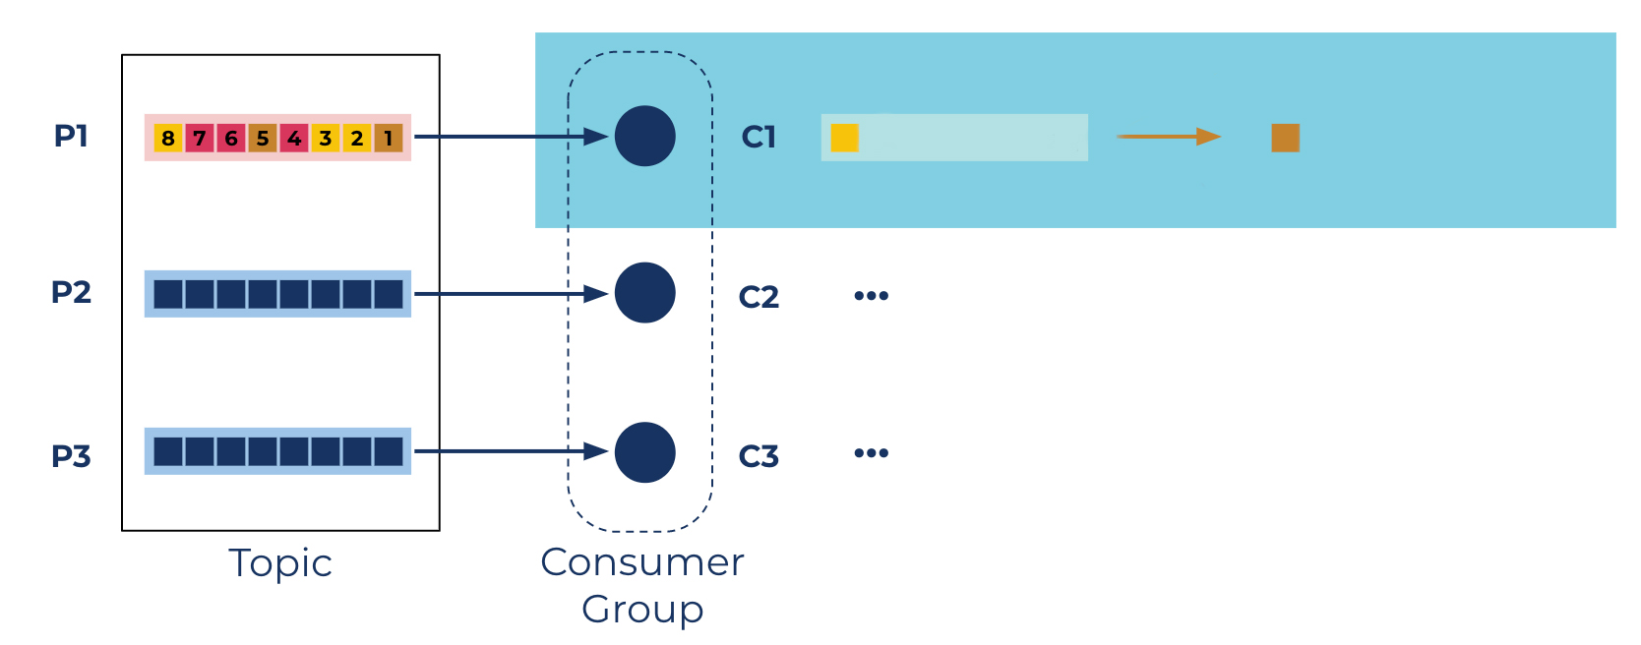
Commons-Messaging Approach
Single
Thread
1
1
Notes:
Mention what happens if message 1 takes too long time.

Slide 11
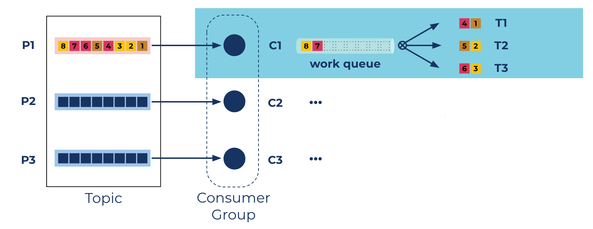
Commons-Events Approach
Multiple
Threads
Multiple
Threads
1
1
Notes:
Commons events provide both sequential and unordered processing capability so it can be used in all types of services.

Slide 12
Integration Steps in Outgoing Payment Service
Eliminating all SCS dependencies
Migrating unit & integration test cases
Changing Consumer and Producer classes to new format

Slide 13
03
Performance Evaluation
How much my worked helped

Slide 14
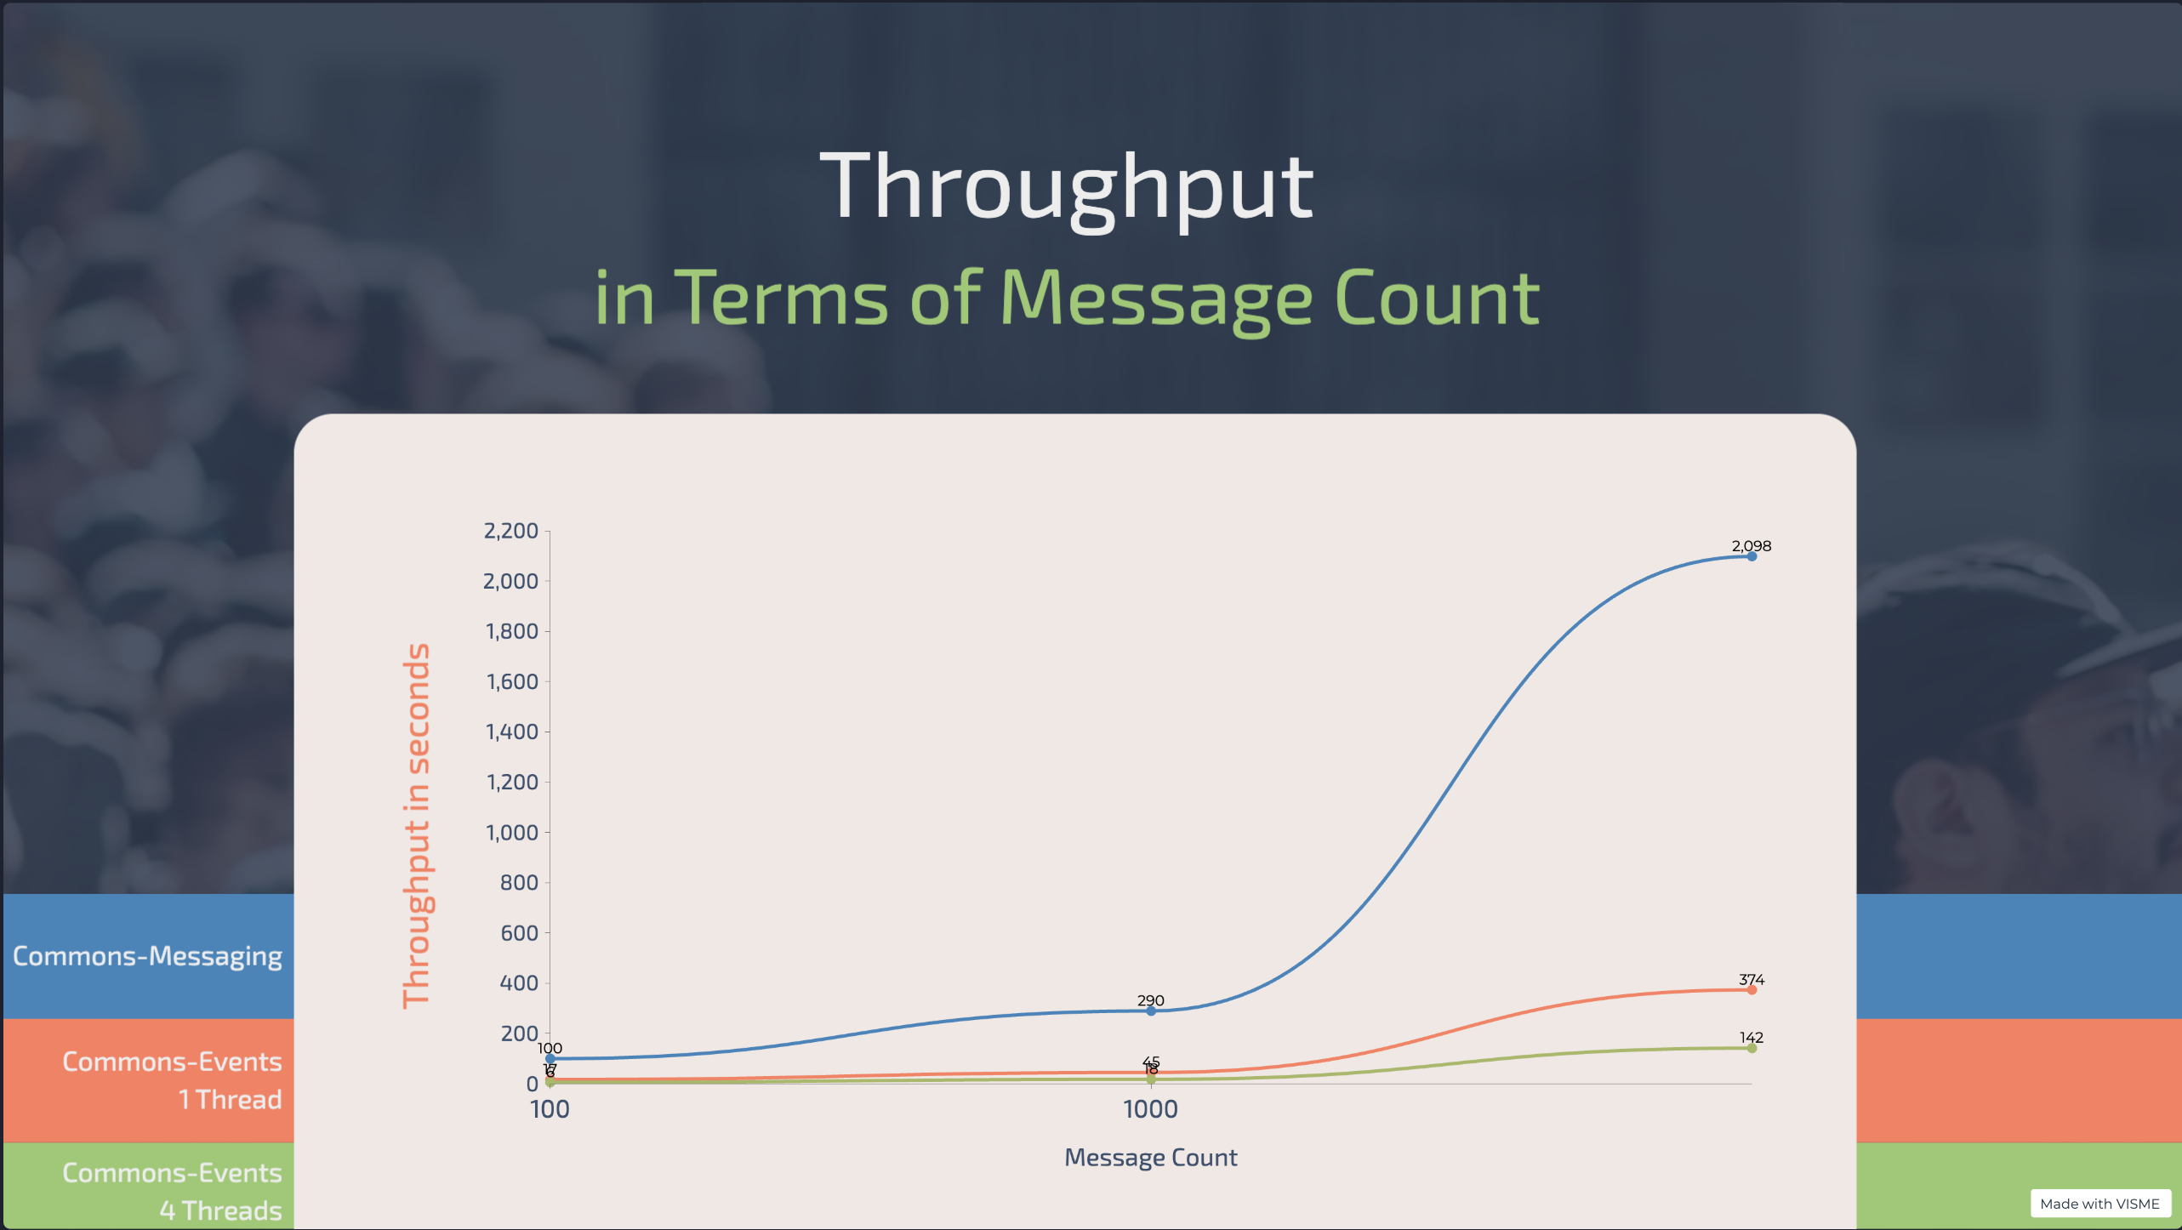

Slide 15
14x Less Time
Yearly Saving 340 Days in Just One Micro Service

Slide 16
04
Insights
Some conclusion I came to

Slide 17
Config Insights
Unordered processing performs much faster than sequential processing
Concurrency level should not be more than the number of available threads

Slide 18
THANKS!
Does anyone have any questions?

